Slide 1


HANDS-ON PROJECT - 3 Understanding Key Metrics via Product Analytics

Slide 2
The Problem Statement
Swiggy recently launched a product to offer home-like meals aimed at increasing daily food ordering. This is targeted towards professionals who don’t have time to cook. The product was launched 3 months back, identify whether the launch was successful and figure out KPIs that will track its progress. Based on the insights drawn, suggest possible changes to the offering to increase adoption.

Slide 3
Market Analysis
Large seller 5%
Though the COVID-19 period demanded the retail market to shift to
Medium seller
the online mode, experts say that several small businesses in India
recognised the potential of online sales 5 years ago. Looking back at its growth since the past decade, government policies such as ‘Digital India’ and ‘Skill India’ are accelerating the process of new-age
technology to go virtual.
20%
Small seller 75%
The e-commerce market in India was valued at INR 6,210.96 Bn in
2021. It is anticipated to reach a value of INR 26,459.18 Bn by the end of 2027 .
Small seller- Less than 2cr income Medium seller- Between 2cr and 7cr Large seller- More than 7cr income
According to a recent report published by the RedSeer, the CAGR for online retail as a whole is predicted to be 25% through Financial Year 2027, wherein MSMEs would outgrow it significantly at a CAGR of
60–70%, contributing $50 billion to the Indian online retail sector.
Medium seller and small seller respective shares of the gross merchandise value (GMV) of Indian e- commerce are 10–18% and 5–10%.
According to industry experts, with 1.5–2.5 million online retailers, the percentage of MSMEs selling goods online is likely to triple to 5-6%
by 2027, reaching 5.5–6 million online MSME retailers.
Source

Slide 4





User Persona
Babita
Age: 35 IT Professional Mumbai, India
Rahul
Age: 28 Buisnessman Delhi, India
Riya Age: 20 Student
Pune, India
Goals
Promote Home Cooked Meals
Gyming and live a healthy lifestyle
Goals
To switch to healthy food habits.
Looking for healthy meal plan subscription which he can share with his coworkers
Goals
To subscribe to some mealplans
Switched to Healthy Lunch Options
Pain Points
She doesn't have a lot of time to Cook
She is into healthy eating but don’t get options
Pain Points
He has to order online food which are mostly unhealthy
Due to unavailability of region based meals he sometimes skipped his meals
Pain Points
She is dependent on Online Food
She doesn’t know Cooking
She is looking for healthy option for lunch and dinner.

Slide 5
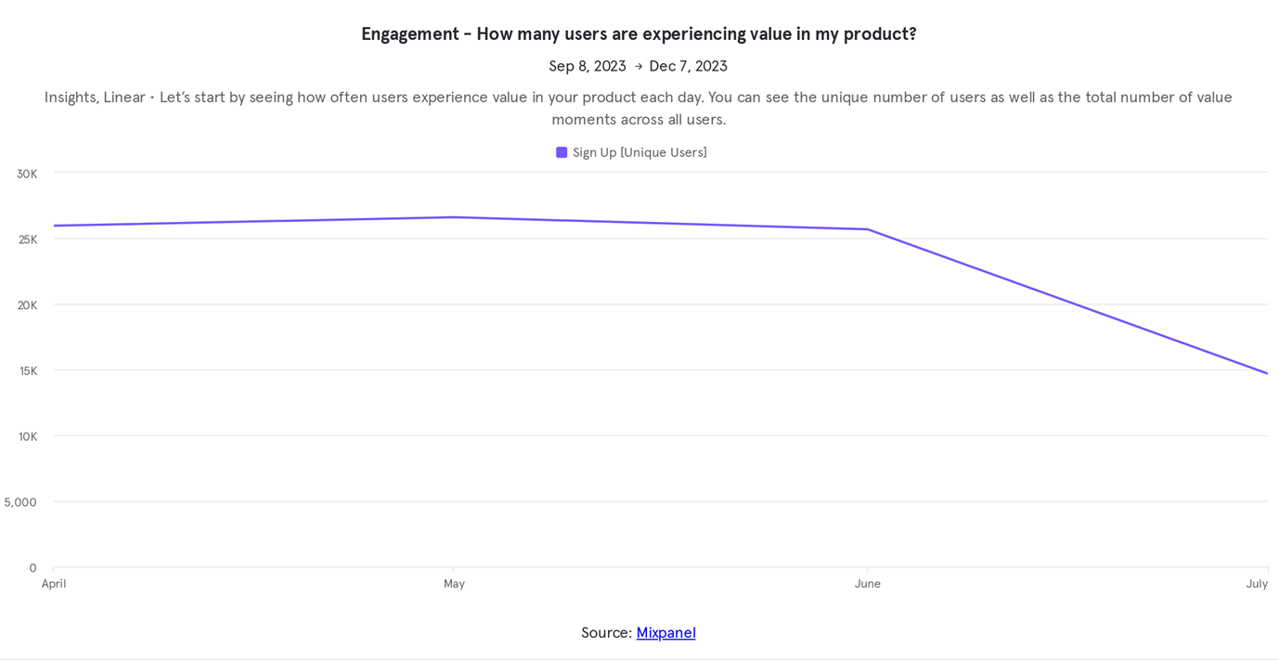
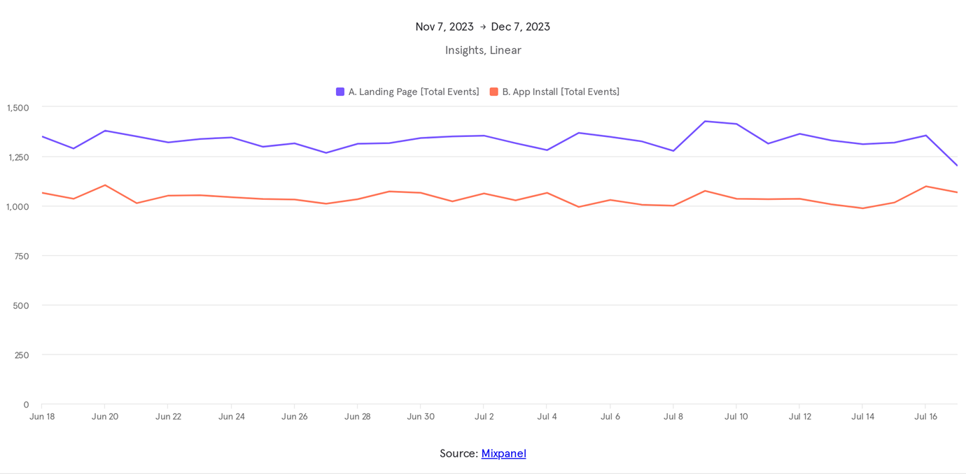
ENGAGEMENT
At Present Swiggy has not yet able to tie up with potential sellers who sells healthy meals. Over the top The sellers yet to understand the full potential and insight of the business.Lack of confidence on delivery partners and high delivery charges in case of single dish and the prices of healthy meal is comparatively higher .What we can find here is Swiggy needs to bring subsidized meals which can attract more consumers
Activation rate helps companies determine how quickly and effectively their users are getting to value. It measures the number of new users that have performed a predetermined “value moment” within a set period of time.

Slide 6
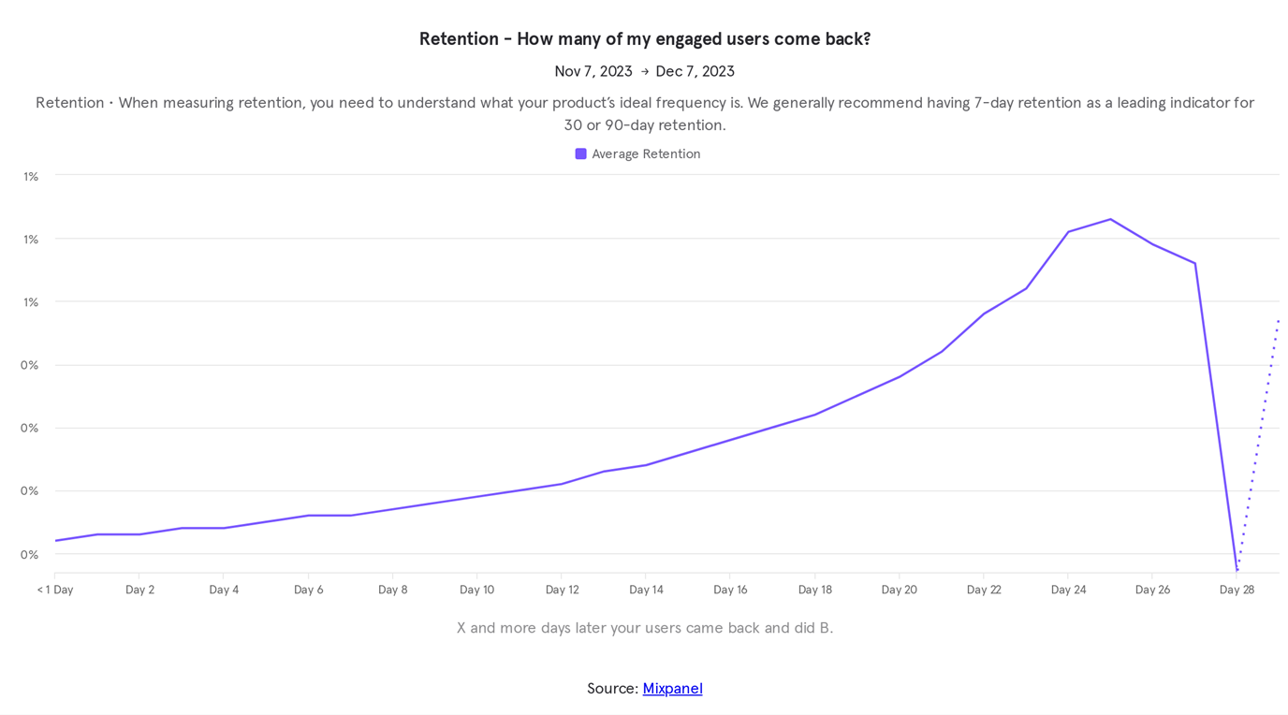
RETENTION
Difficulty Incorporating Product Variants Leads to Negative Seller Impressions
A vast majority of products come in different tastes yet sellers are unable to add various options to their products. This issue has created a poor impression among many users

Slide 7
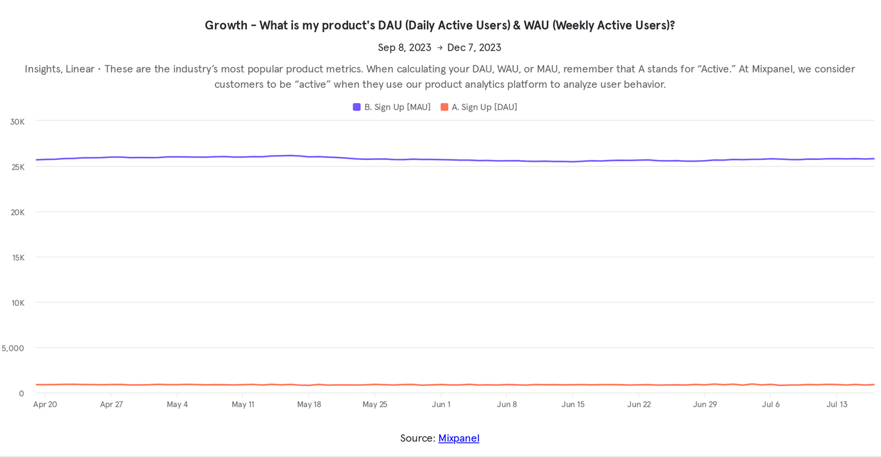
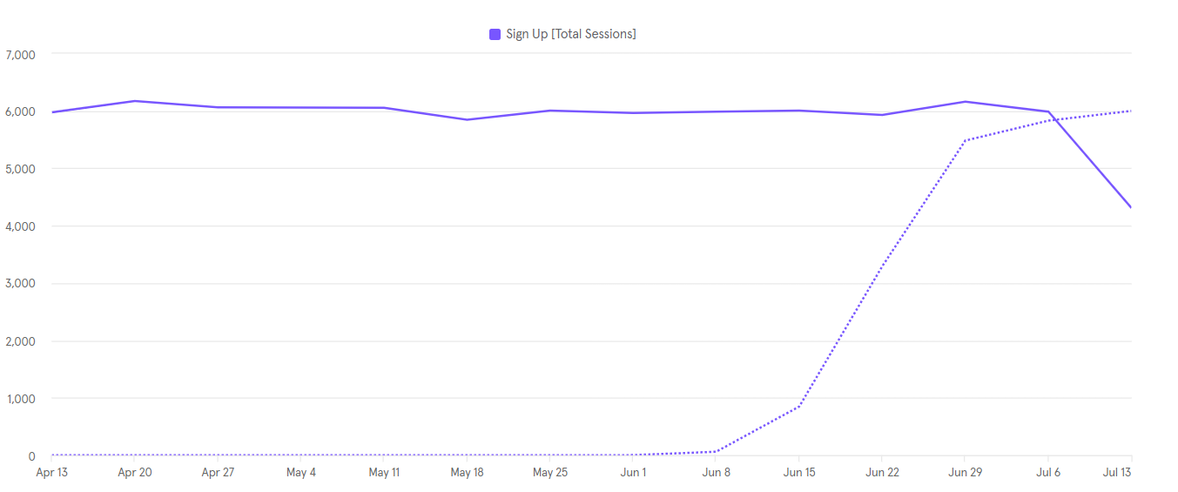
GROWTH
Swiggy Meals current model lacks a viable approach for expanding its network.
Presently, Swiggy delivering meals through distinguished Restaurant chain .They are yet to partner with canteens ,Tiffin delivery, local Pice hotels who deliver affordable healthy meals
However, if sellers already possess a substantial network to share their store link with, then why would the seller adopt Swiggy Meals in the first
place.

Slide 8
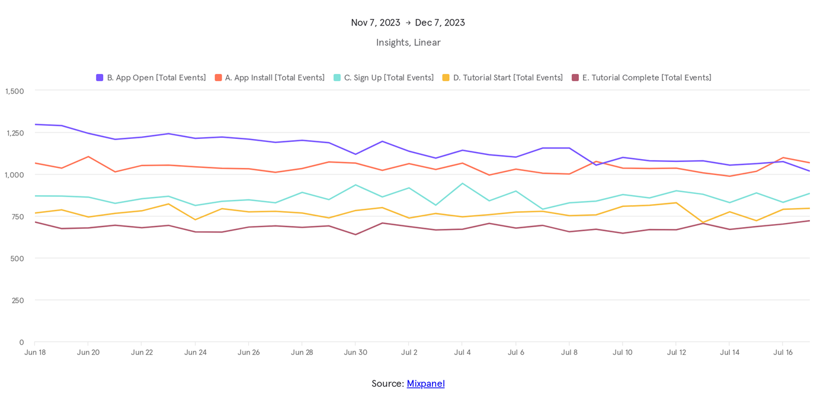
ADOPTION
Customers are experiencing difficulty in locating the Swiggy Meals option within the Swiggy app. Presently, the app only displays the selective restaurants once the customer has clicked on a meals store link. Proper filter is missing for “Healthy Meals”. User cannot sort Meals based on price ,cuisine. The customers' unfamiliarity with
purchasing products from these stores is hindering the adoption rate of this feature. This issue needs to be addressed urgently to improve the overall customer
experience.

Slide 9
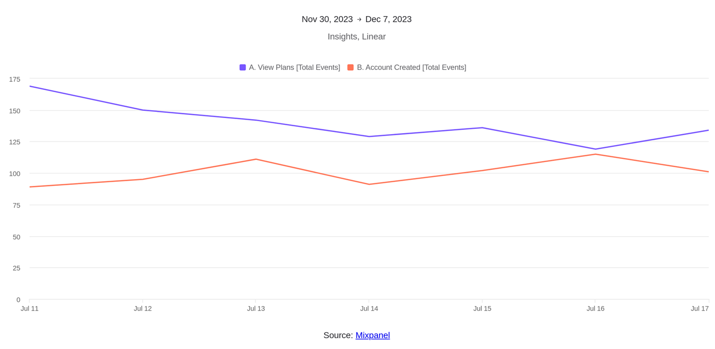
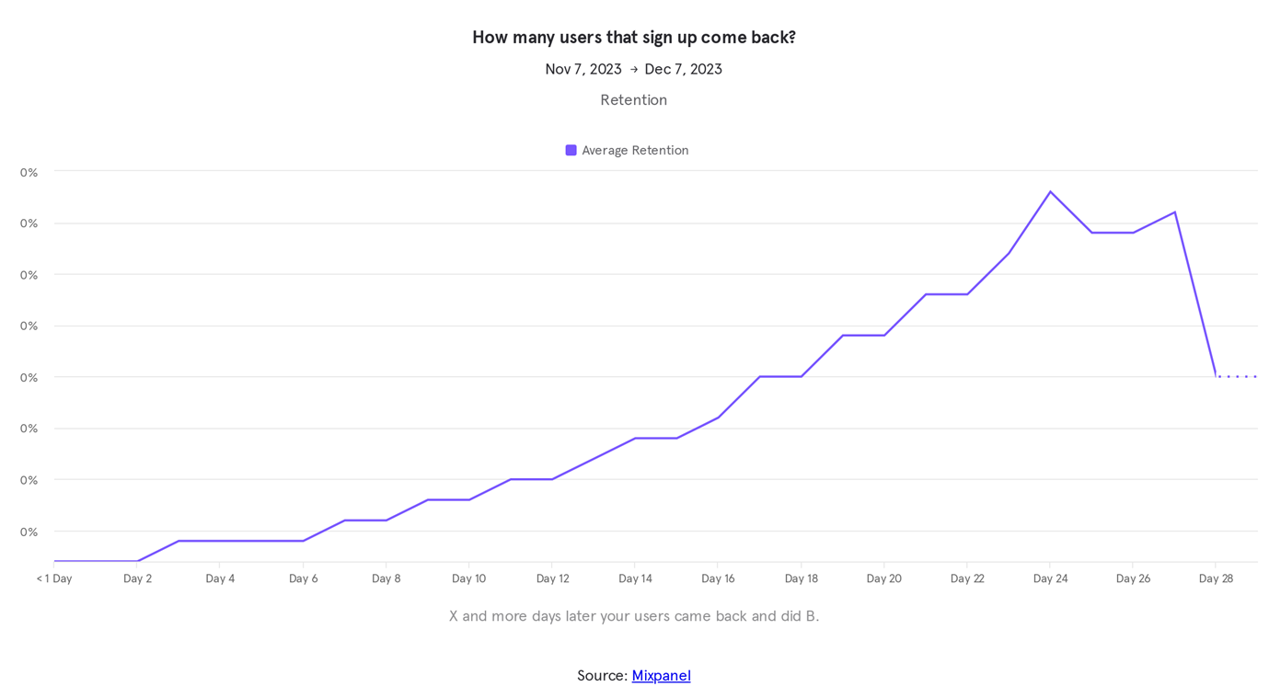
User conversion Report
Supporting multiple languages and multilingual product descriptions can increase More Footfalls. What user needs is good customer support , Quick Order delivery and viable Seller partners. With diversified taste Indian users looks for cheaper and affordable solutions when it comes to meals

